Slide 1



E-commerce sales Report
View in Power BI
Last data refresh:
3/3/2024 5:09:14 AM UTC
Downloaded at:
3/3/2024 5:30:54 AM UTC

Slide 2
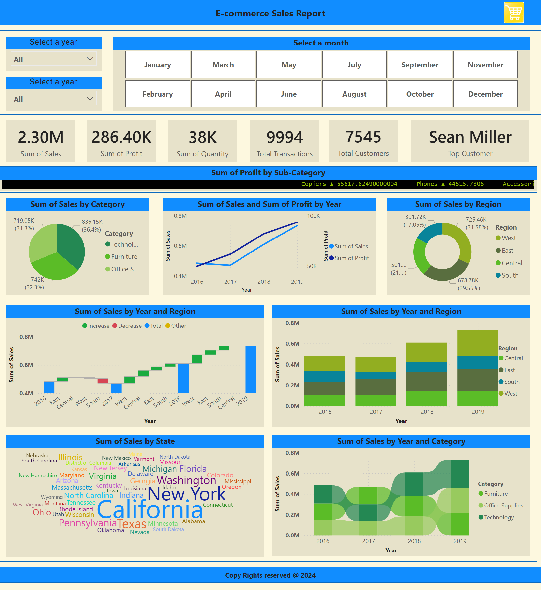
Page 1
Notes:
card
No alt text provided
card
No alt text provided
card
No alt text provided
shape
No alt text provided
Select a year
No alt text provided
Select a year
No alt text provided
Select a month
No alt text provided
shape
No alt text provided
card
No alt text provided
card
No alt text provided
card
No alt text provided
shape
No alt text provided
ScrollingTextVisual1448795304508
No alt text provided
shape
No alt text provided
pieChart
No alt text provided
donutChart
No alt text provided
lineChart
No alt text provided
waterfallChart
No alt text provided
columnChart
No alt text provided
WordCloud1447959067750
No alt text provided
shape
No alt text provided
shape
No alt text provided
ribbonChart
No alt text provided
image
No alt text provided
shape
No alt text provided
image
No alt text provided

